Slide 1
Domestic Violence in New York City: 2020 -2021
Katrina Azzara
June 2, 2025

Slide 2
Research Questions
How has the number of domestic violence related incidents changed over time?
Does location (borough and community district) impact the volume of domestic violence related incidents?
Does a combination of poverty rate and borough impact the volume of domestic violence related incidents?

Slide 3
Dataset
Obtained from NYC Open Data
Agency: Mayor's Office to End Domestic and Gender-Based Violence (ENDGBV)
Name: “ENDGBV: The Intersection of Domestic Violence, Race/Ethnicity and Sex”
Description: Contains incident level data from the New York City Police Department on domestic violence related offenses* with report dates occurring between 2020 and 2021.
Last updated in January 2024
Contains 15 columns and 483,790 rows
Link: https://data.cityofnewyork.us/Public-Safety/ENDGBV-The-Intersection-of-Domestic-Violence-Race-/2rb7-7eqa/about_data
*Domestic violence related offenses defined as felony assaults, felony rapes and domestic incident reports

Slide 4
Methodology
Data cleaning and analysis were conducted in Python utilizing:
Pandas, Seaborn, Numpy and Matplotlib
Data Cleaning Steps Included:
Changing the “Report Date” field from an object dtype to a datetime dtype
Recoding race related variable so that “Hispanic” is represented as its own category as opposed to breaking out into Hispanic Black and Hispanic White
Removing columns not relevant to the current analysis
Removing rows that contained report dates in 2019 (n=2)
Bar charts and tables were created to address the research questions

Slide 5
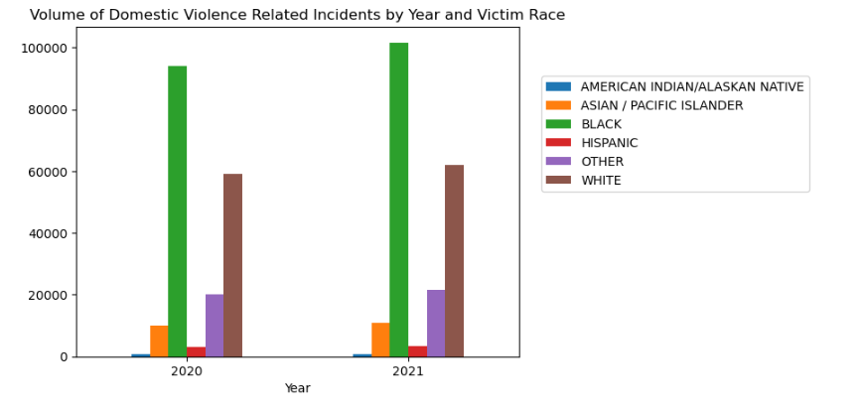
Results and Demographics
The number of domestic violence related incidents in 2020 (n=242,040) was similar to that of 2021 (n=241,748)
In both 2020 and 2021:
There were more female victims of domestic violence than males among those who reported their gender
Among victims who reported their race, those who identified as Black experienced the highest number of DV related incidents followed by those who identified as White

Slide 6
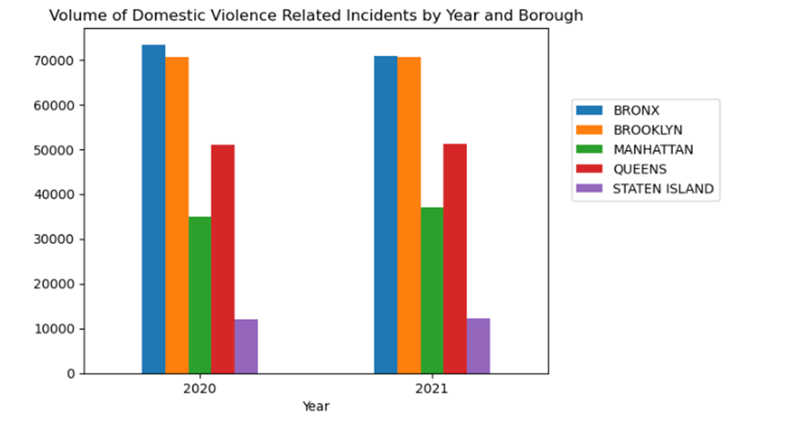
Results by Year and Borough
In both 2020 and 2021, the borough with the highest number of domestic violence related incidents was the Bronx followed by Brooklyn

Slide 7
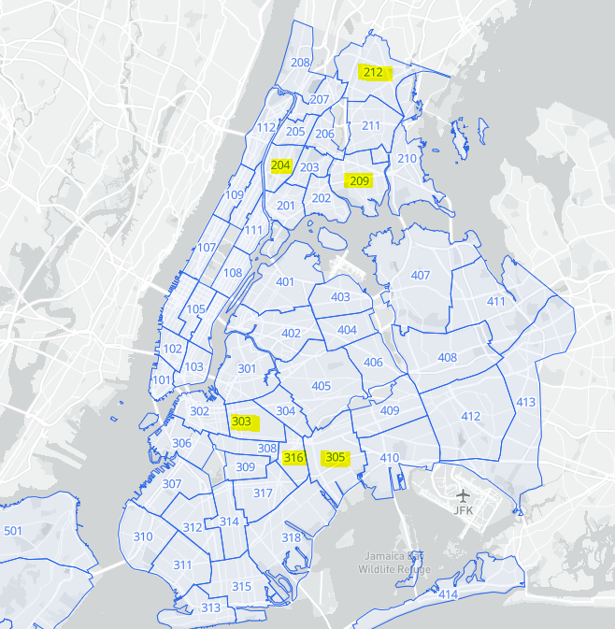
Results: Community Districts
NYC can be broken down into 59 community districts
Incidents by Community District of where the Offense Occurred: 2020 and 2021
In the Bronx, the 3 community districts with the highest number of incidents were: 209, 212 and 204
In Brooklyn, the 3 community districts with the highest number of incidents were: 305, 316 and 303
Given that the same districts were identified in 2020 and 2021, these locations may be good candidates for investment of domestic violence related resources
Map above is from the NYC Boundaries Map
Link: https://boundaries.beta.nyc/?map=cd

Slide 8
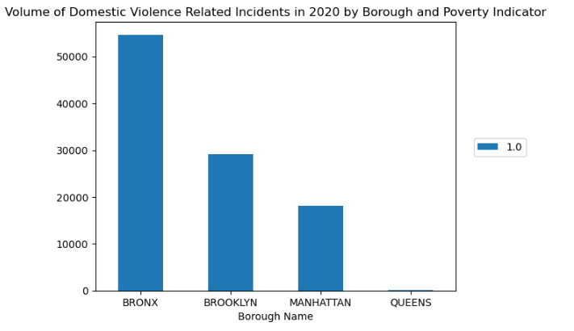
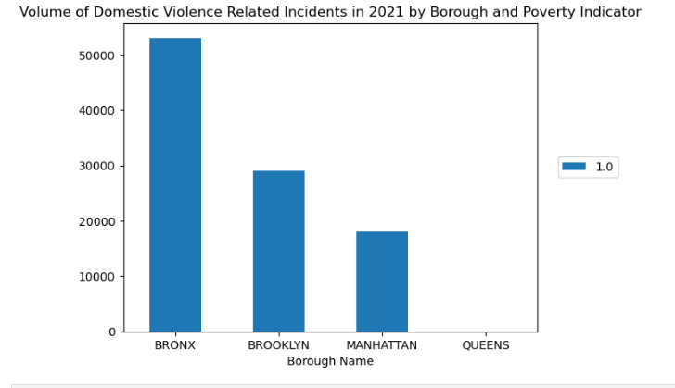
Results: Poverty
In 2020 and 2021, among locations where a domestic violence related incident occurred, the Bronx and Brooklyn had the largest number of community districts with a high poverty rate*.
*Poverty Rate was an existing field in this dataset determined using quartiles based on the 2014-2018 American Community Survey 3-Year Estimates, Selected Economic Characteristics.

Slide 9
Summary and Discussion
Summary
The highest number of domestic violence related incidents occurred in the Bronx followed by Brooklyn, in both 2020 and 2021
Within the Bronx, community districts 209, 212 and 204 had the highest number of incidents while in Brooklyn, they were districts 305, 316 and 303.
The Bronx and Brooklyn had the largest number of community districts with a high poverty rate.
There were more female victims of domestic violence related incidents than males
Among victims who reported their race, those who identified as Black experienced the highest number of domestic violence related incidents followed by those who identified as White
Discussion
Given the results of this analysis, domestic violence related resources that support individuals in the Bronx, specifically in community districts: 209, 212 and 204 and Brooklyn, specifically in districts 305, 316 and 303 may be helpful.
In addition, these resources may want to set their target demographic population to Black and White females to provide the most impact. Attention should also be paid to districts with high poverty rates.

Slide 10
Limitations & Next Steps
Limitations
The data used in this analysis referred to report dates between 2020 and 2021 which were during the COVID-19 pandemic. Patterns of domestic violence related incidents found in this analysis may be significantly different than pre or post pandemic periods
To be included in the dataset, the domestic violence related incident must have been reported to the NYPD
Missing data for race and gender related variables ( >5%)
Next Steps
Future research should investigate whether the patterns found in this analysis remain consistent in more recent, post-COVID, years
In addition, research specifically designed to create predictive models/assign risk levels for experiencing domestic violence related incidents within a given timeframe could help to bring domestic violence related resources to those most in need

